Slide 1
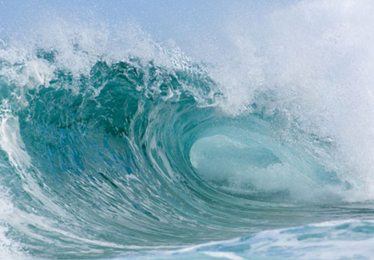
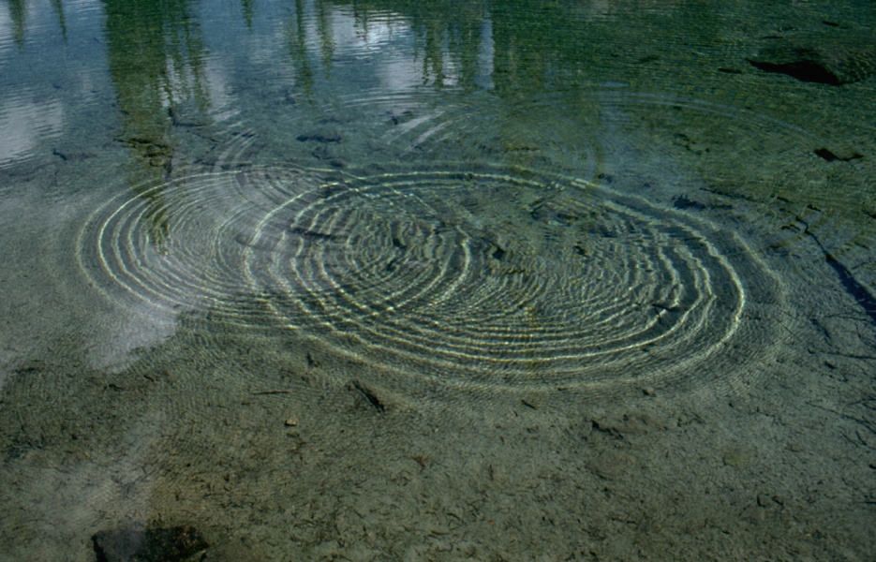
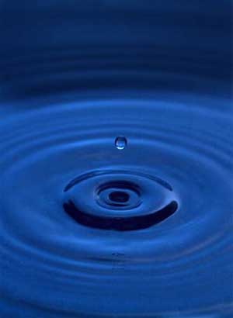
Introduction to Waves

Slide 2
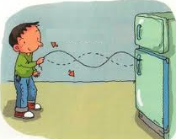

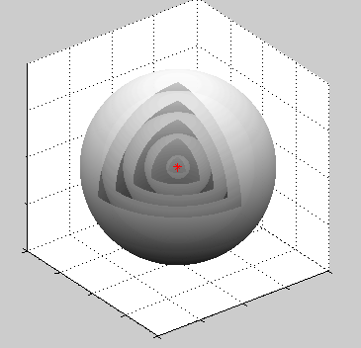
What is a wave?
A vibration that travels through
space and transmits energy.
Waves can travel in 1, 2 or 3 dimensions!
Sound waves spreading out from point source
3D
Wave in a string-
1D
Wave in a pond-
2D
Animation…

Slide 3
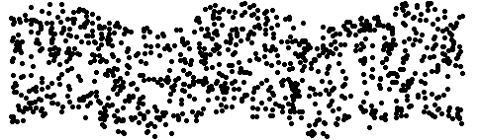
Types of 1D waves
Transverse Waves
particle motion is perpendicular
to direction of wave motion
Particle
Vibration
Wave propagation direction

Slide 4
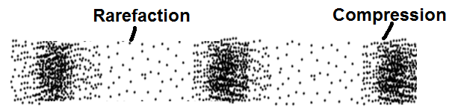
Longitudinal Waves
particle motion is parallel
to direction of wave motion
Particle
Vibration
Wave propagation direction

Slide 5
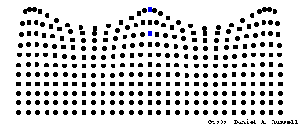
Water Waves
A combination of longitudinal and transverse motion
Particle
Vibration
Wave propagation direction
Particles travel in clockwise circles!!
Wave animations….

Slide 6
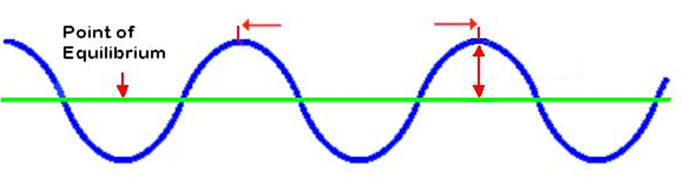
Wave Properties
Wavelength
Amplitude
Wavelength ( λ) Units: m
-distance between any two
successive points in phase
Amplitude (A) Units: m
-maximum displacement of a
particle from its rest position

Slide 7
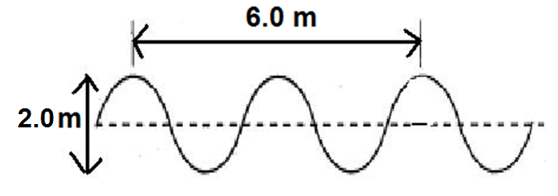
Example 1: For the wave below
a) State the wave type
b) Determine the amplitude (A)
c) Determine the wavelength (λ)
Answer:
a) transverse
b) 2A= 2.0 m
A = 1.0 m
c) 2λ= 6.0 m
λ = 3.0 m

Slide 8
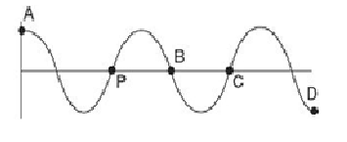
Phase- a particular point in the cycle of a wave
Ex. 2: Which point(s) is/are in phase with point P?
Answer:
Only point C is in phase with point P!

Slide 9
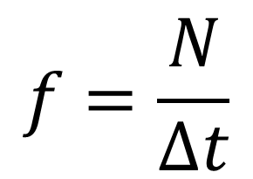
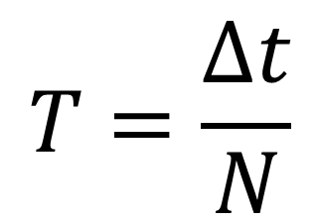
Period (T): Units: s
-the time for one full vibration cycle
Frequency (f): Units: s⁻¹ or Hertz
-inverse of period (f=1/T)
-the number of cycles per second
Calculating period and frequency:
Given N cycles counted over a time interval of Δt:
$$T=\frac{∆t}{N}$$
$$f=\frac{N}{∆t}$$
and

Slide 10
Ex. 3:
You are at the beach watching waves lap up against the shore. You count 5 waves lapping up every 2.0 seconds. What is the period and frequency?
Ans:
N= 5
t= 2.0 s
f=?
T=?
f= N
Δ t
= 5
2.0 s
= 2.5 Hz
T= Δt
N
= 2.0 s
5
= 0.40 s

Slide 11
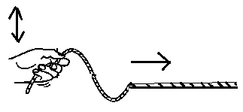
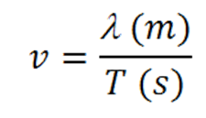
The Universal Wave Equation
Recall: Speed=distance or v= Δd
time Δ t
For a wave:
distance = length of one cycle (wavelength-λ)
time= time of one cycle (period T)
Speed equation becomes:

Slide 12


The Universal Wave Equation
Ex. 4:
You are at the beach watching waves lap up against the
shore. You count 12 waves lapping up every 15.0
seconds. What is the wave frequency?
b) You also notice that there is 3.50 m between successive crests of the wave. What is the wave speed?
Ans: a) 0.800 Hz b) 2.80 m/s

Slide 13
What determines Wave Speed?
The speed of a wave is determined by the material it travels in.
Example: The speed of waves travelling in a string is controlled by tension.
High tension= high speed
Low tension=low speed

Slide 14
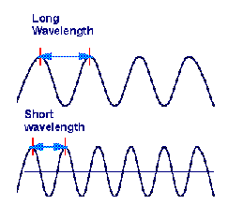
Relationship between wavelength and frequency:
For a given medium, wave speed, v, is constant!
Frequency and wavelength are inversely proportional!
f ↑, λ ↓
f ↓, λ ↑
Low frequency
High frequency

